Slide 1

CULTURE

Slide 2
“Culture is the framework of beliefs, expressive symbols, and values in terms of which individuals define their feelings and make their judgements” (Geertz 1957 American Anthropologist 59:32-54).
`an historically transmitted pattern of meaning embodied in symbols, a system of inherited conceptions expressed in symbolic form by means which men communicate' (Geertz 1973: 89).
“Cultures are traditions and customs, transmitted through learning, that form and guide the beliefs and behaviour of the people exposed to them.... Cultural traditions include customs and opinions developed over the generations about proper and improper behaviour” (Kottak 2008)

Slide 3
Culture is a way of life
Ideas
Attitudes
Values
Material
Objects
Behaviour
Patterns
“Everything that people have, think, and do as members of a society” (Ferraro, 2008)
Culture is Relative

Slide 4
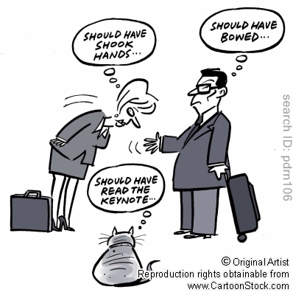

Slide 5
Elements of Culture

Slide 6


Elements of Culture
Language
Shelter
Clothing
Economy
Religion
Education
Values
Climate
Government/Laws
Recreation/Entertainment

Slide 7
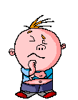


Education
- the development of the mind and character through study and training

Slide 8


Language
- spoken or written words; human speech

Slide 9



Shelter
- something that protects from the weather or from danger.

Slide 10
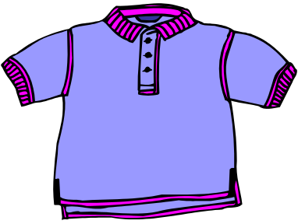


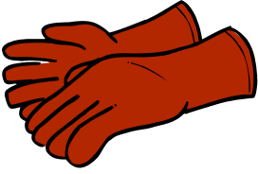
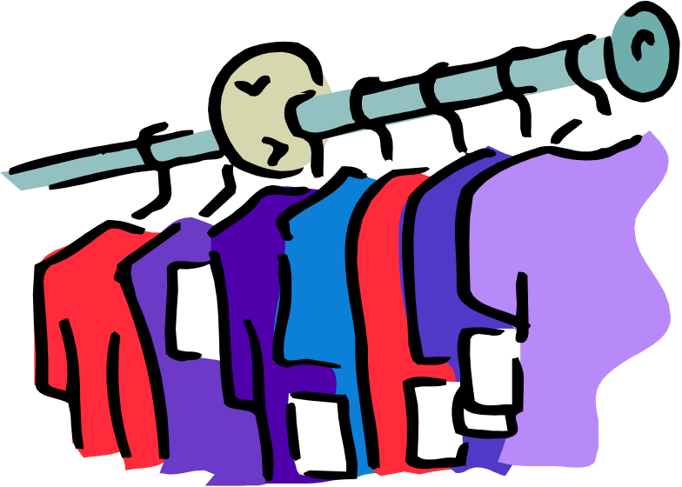

Clothing
- things worn to cover the body

Slide 11

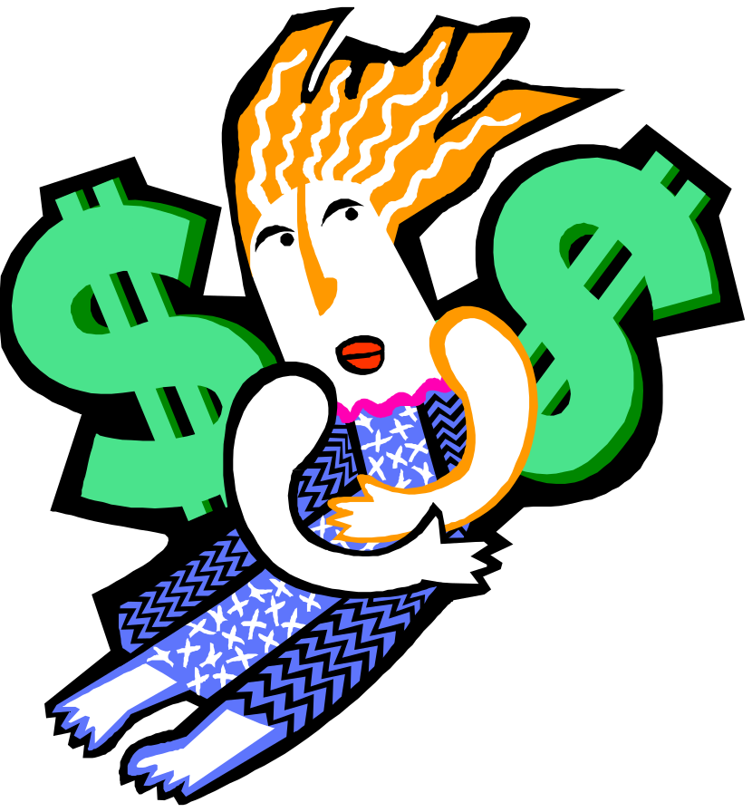
Economy
- the way that money and goods are used by people

Slide 12

Religion
- a system of beliefs that goes beyond human powers

Slide 13
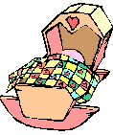
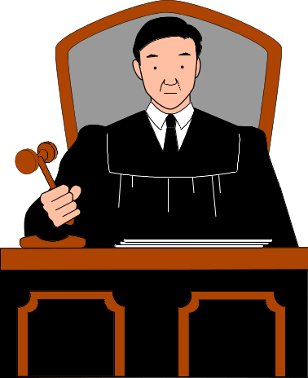

Values
- ideals or beliefs that guide the way people live

Slide 14



Climate
- the usual weather that a place has

Slide 15
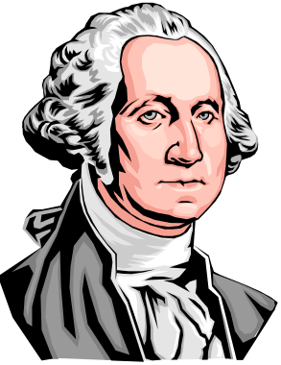
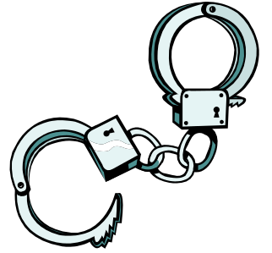
Government/Laws
- rules made and enforced by the government of a country
-

Slide 16


Entertainment/Recreation
- something that is done for fun or relaxation

Slide 17


Cross-Cultural Skills
International managers are now not only expected to be familiar with country marketing reports but should also conduct research on their business partners’ culture and regional etiquette.
Stereotypes are the first source of information about cultures, but every negotiator is still an individual.
Notes:
2

Slide 18
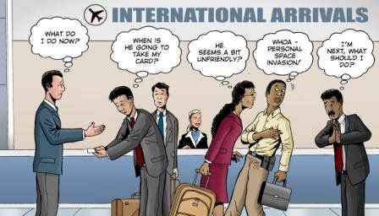
Cross-Cultural Skills
Negotiators should accept the fact, that the members of the opposite party behave in different ways: it is not right or wrong, it is only different.
A lack of knowledge about foreign cultures can lead to misunderstanding, frustration and even loss of business.
Notes:
2

Slide 19
Characteristics of Culture
Culture is learned
Culture is unconscious
Culture is shared
Culture is integrated
Culture is Symbolic
Culture is a way of life
Culture is Dynamic
Culture is Relative

Slide 20
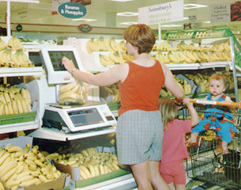
Culture is learned
How do we learn our culture?
Enculteration

Slide 21

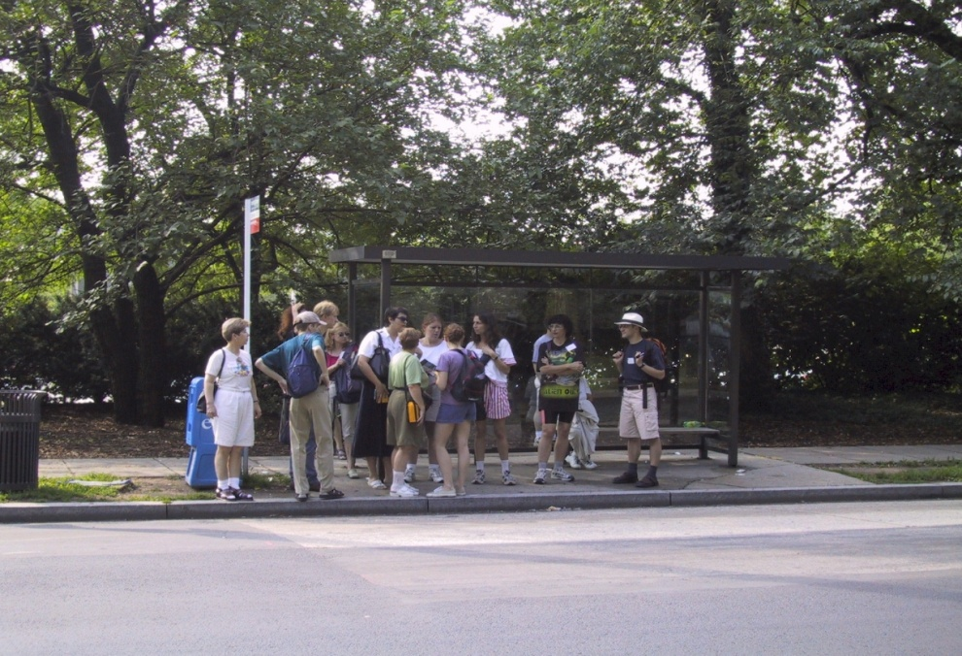
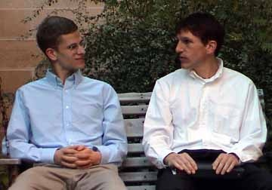
Culture is unconscious

Slide 22
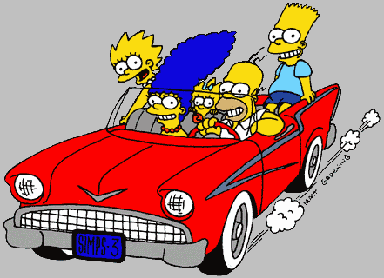
Culture is shared

Slide 23

Culture is Relative
Should everyone use a deodorant?
USA 89%
French Canada 81%
English Canada 77%
United Kingdom 71%
Italy 69%
France 59%
Australia 25%

Slide 24
Culture is Integrated
Economics
Kinship
Law
Religion
Medicine

Slide 25

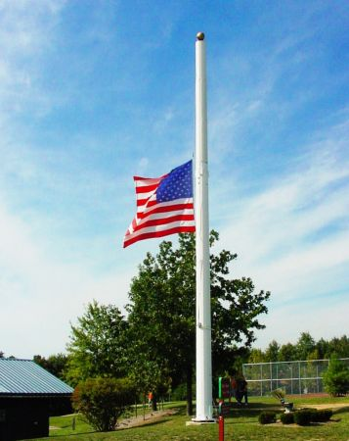
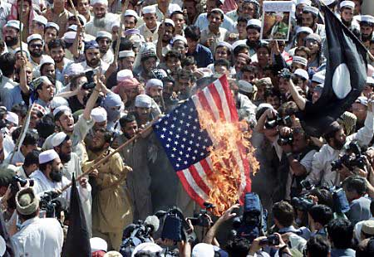
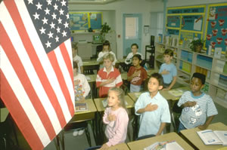
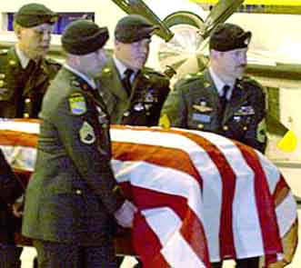
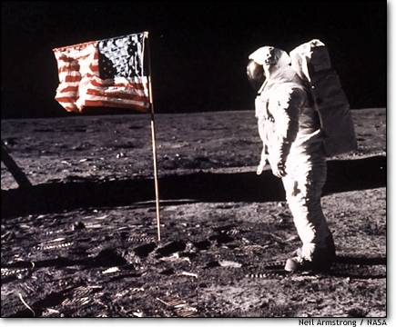

Culture is Symbolic

